Slide 1
URBAN FARMING AND SECURITY
The significance of farming for food security

Slide 2
Urban farming and security
Food security is a state that guarantees the sufficient availability of food within the country , affordable and accessible. Farming is an integral part of food security; through farming various food products can be harnessed. In the US there are about 10 cities that have progressed following the implementation of urban agriculture ordinance based on innovation.

Slide 3
Detroit, Michigan
In the above cities, a Food Policy Council was introduced in 2009. The objective was to study the local food systems along with urban agriculture and establish how best to implement.
The zoning strategy has brought the attention and focus on food production which has led to the rise of community gardens, food trucks, small urban growers and market s for farmers.

Slide 4
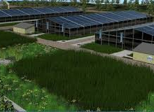
Urban farming in Detroit
Detroit city is amongst the city that have embraced urban farming and the size of impact has been experienced. The economy within the city has greatly improved plus the living standards of people. Food security is critical for a healthier society.

Slide 5
Minneapolis, Minnesota
The Urban Agriculture Policy Plan was adopted in 2011 by the Minneapolis City. The plan recommended improvement of urban growers and gardeners. As a result of the policy, the city continuous to promote urban agriculture and increasing local fresh food that is accessed to the residents.

Slide 6
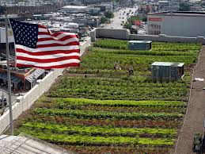
Urban farming in the US
Urban farming in the US is transforming the economy of most cities which have embraced. Also, the communities that practised have benefited a lot due to food security and earning income.

Slide 7
Significance of urban family
It acts as source of income for many people and families at large.
Families can be able to access fresh and healthy food at all time which is good for body growth and development.
Encourages sustainability
Promotes the growth and development of food security.
Promotes the local economy creating a healthy society and well educated.
Creation of employment

Slide 8
Conclusion
The above is just an example of cities that have impressed urban agriculture, however using the two examples all cities can also join. Agriculture ensures that food is available, affordable and accessible at any time. However the government should be supportive by creating a conducive environment in terms of policies.

Slide 9
References
http://seedstock.com/2014/05/27/10-american-cities-lead-the-way-with-urban-agriculture-ordinances.

